Slide 1
SORTING

Slide 2
Sort
Definition:
Sorting: The process of arranging data in a particular order (ascending or descending).
Types of Sorting Algorithms:
Comparison-based: Algorithms that sort by comparing elements (e.g., Bubble Sort, Quick Sort, Merge Sort).
Non-comparison-based: Algorithms that use other techniques (e.g., Counting Sort, Radix Sort).

Slide 3
Common Algorithms
Bubble Sort: Repeatedly swaps adjacent elements if they are in the wrong order.
Selection Sort: Selects the smallest element from the unsorted part and swaps it with the first unsorted element.
Insertion Sort: Builds the sorted array one element at a time by repeatedly inserting the next element into the correct position.
Merge Sort: Divides the array into halves, recursively sorts each half, and then merges the sorted halves.
Quick Sort: Picks a pivot element, partitions the array around the pivot, and recursively sorts the partitions.

Slide 4
Bubble Sort
A simple comparison-based sorting algorithm that repeatedly steps through the list, compares adjacent elements, and swaps them if they are in the wrong order.
Algorithm
Start from the beginning of the list.
Compare each pair of adjacent elements.
Swap them if they are in the wrong order.
Repeat the process for the entire list until no more swaps are needed.
Time Complexity: Average and Worst Case : O(n^2).
Space Complexity: O(1)

Slide 5
Bubble Sort Pseudo Code
BubbleSort(array)
n = length(array)
for i from 0 to n-1
for j from 0 to n-i-2
if array[j] > array[j+1]
swap(array[j], array[j+1])

Slide 6
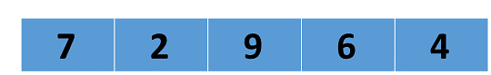
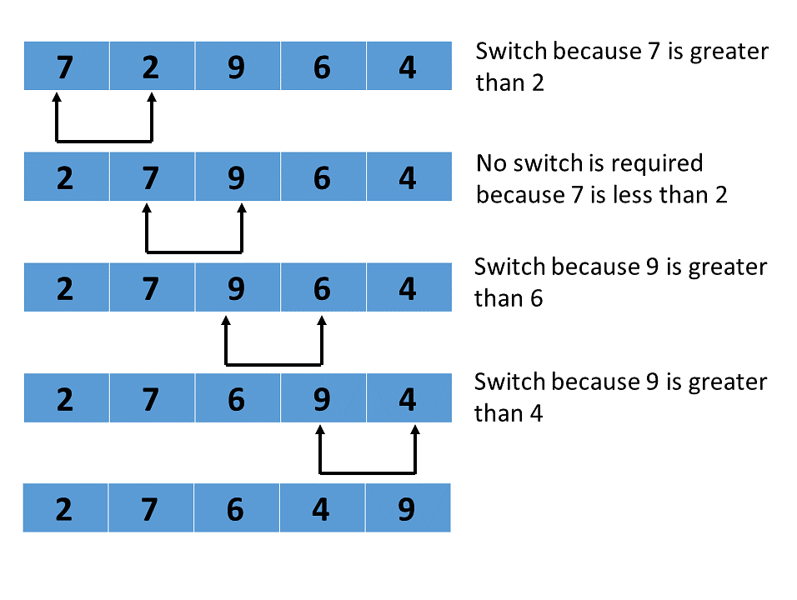
example
1st pass

Slide 7
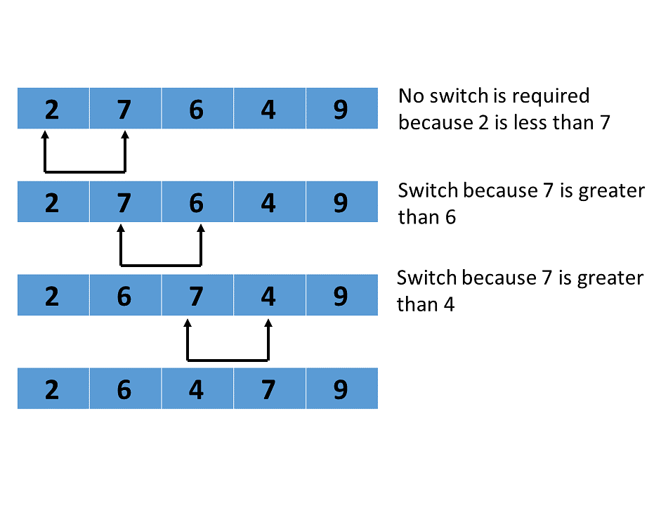
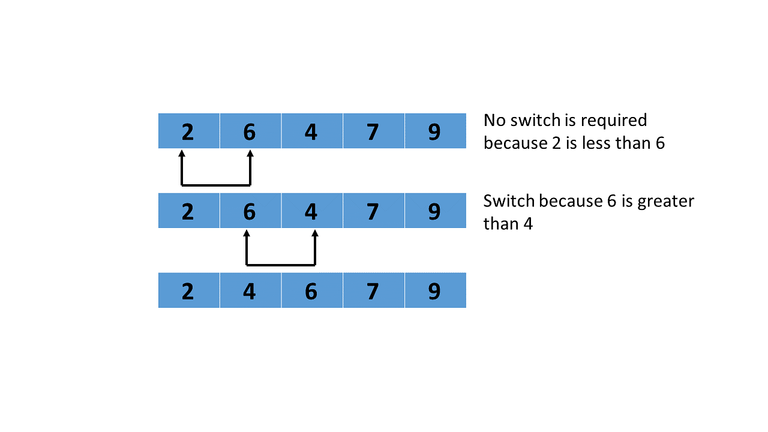
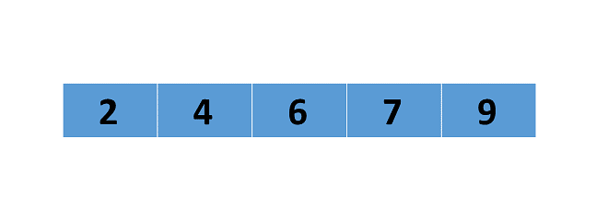
2nd PASS
3rd PASS
4th PASS

Slide 8
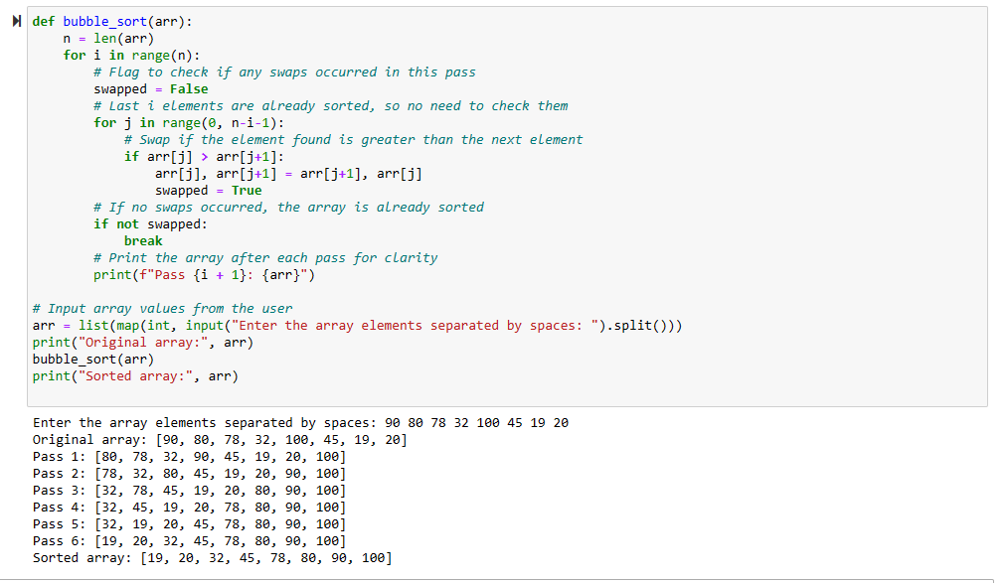
code

Slide 9
Insertion Sort
Nishan Neupane
Roll:18

Slide 10
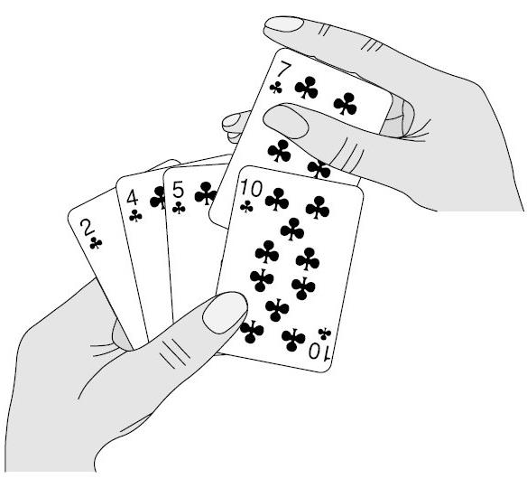
Introduction
Insertion sort is a simple sorting algorithm that builds the final sorted array (or list) one element at a time.
Insertion sort is nothing but inserting elements at their right position comparing others. which is similar how we sort deck of cards in our hands.

Slide 11
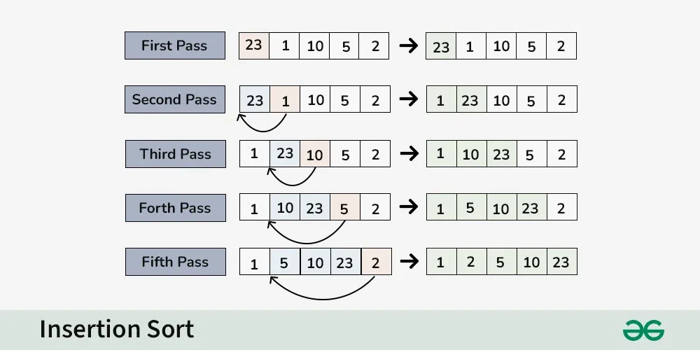
Algorithms
We have to start with second element of the array as first element in the array is assumed to be sorted.
Compare second element with the first element and check if the second element is smaller then swap them.
Move to the third element and compare it with the second element, then the first element and swap as necessary to put it in the correct position among the first three elements.
Continue this process, comparing each element with the ones before it and swapping as needed to place it in the correct position among the sorted elements.
Repeat until the entire array is sorted

Slide 12
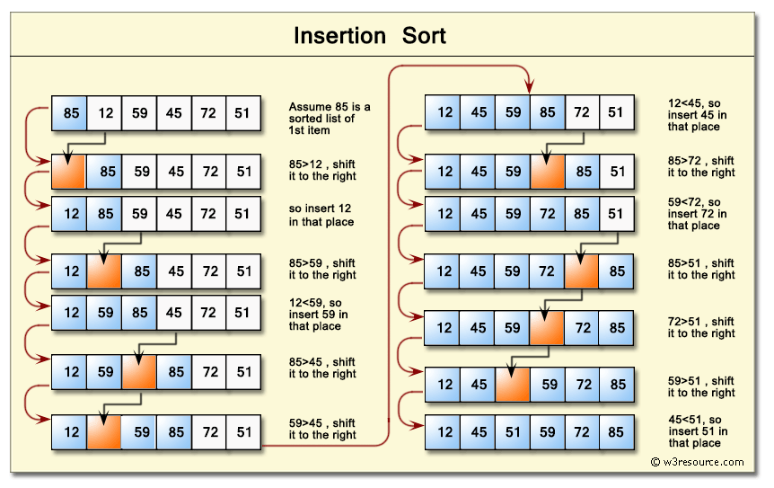

Slide 13
Time Complexity
Best Case: O(n) - When the array is already sorted.
Average Case: O(n^2) - When elements are randomly ordered.
Worst Case: O(n^2) - When elements are sorted in reverse order.
Note: Despite the quadratic time complexity, insertion sort can be faster than other algorithms for small datasets.
Space Complexity
O(1) - Requires only a constant amount of additional memory space.
Efficient memory usage, making it suitable for environments with limited memory.

Slide 14
Pseudocode
for i = 1 to n
key = array[i]
j = i - 1
while j >= 0 and array[j] > key
array[j + 1] = array[j]
j = j - 1
array[j + 1] = key

Slide 15
MERGE SORT
Manoj Gautam
Roll No: 17

Slide 16
TABLE OF CONTENT
INTRODUCTION
FLOWCHART OF MERGE SERT
EXAMPLE OF MERGE SORT
Advantage of merge sort
Disadvantage of merge sort
CONCLUSION

Slide 17
INTRODUCTION:
Merge sort is a versatile and efficient sorting algorithm based on the divide-and-conquer strategy.
It offers stable sorting, predictable performance, and is suitable for various applications.
Understanding the principles and variants of merge sort can help in making informed decisions for sorting task

Slide 18
Methodology
Divide: Divide the unsorted array into two halves until each sub-array contains only one element.
Conquer: Recursively sort each sub-array.
Merge: Merge the sorted sub-arrays to produce the final sorted array.

Slide 19
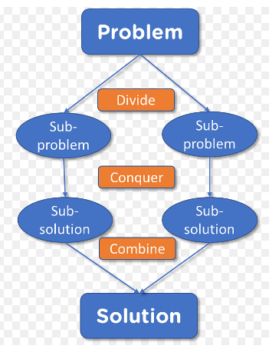
Flowchart of Merge Sort

Slide 20
Example:-
an unsorted list: [25, 57,48, 37, 12, 92, 86, 33].
To sort above list, list is divided into smaller sub lists, sorted individually, and then merged back together.
Final sorted list: [12, 25, 33, 37, 48, 57, 86, 92].

Slide 21
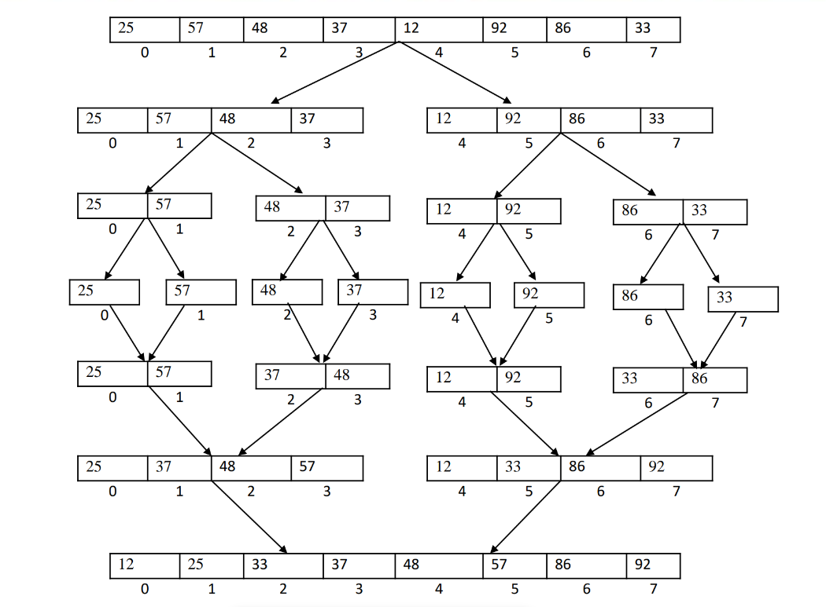
Source: Nabaraj sir slide

Slide 22
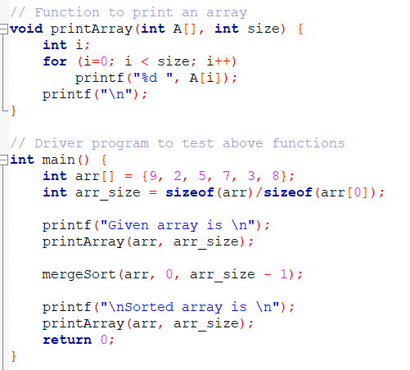
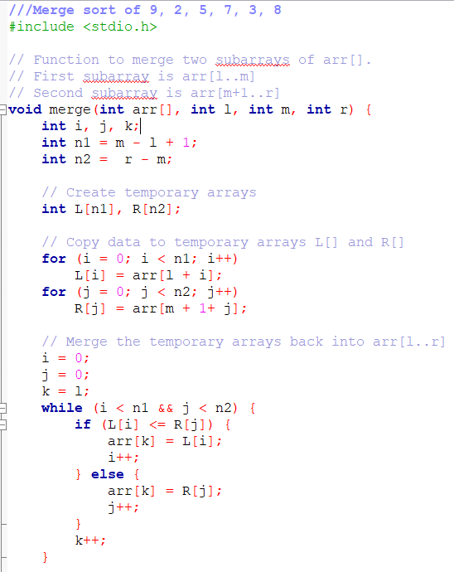
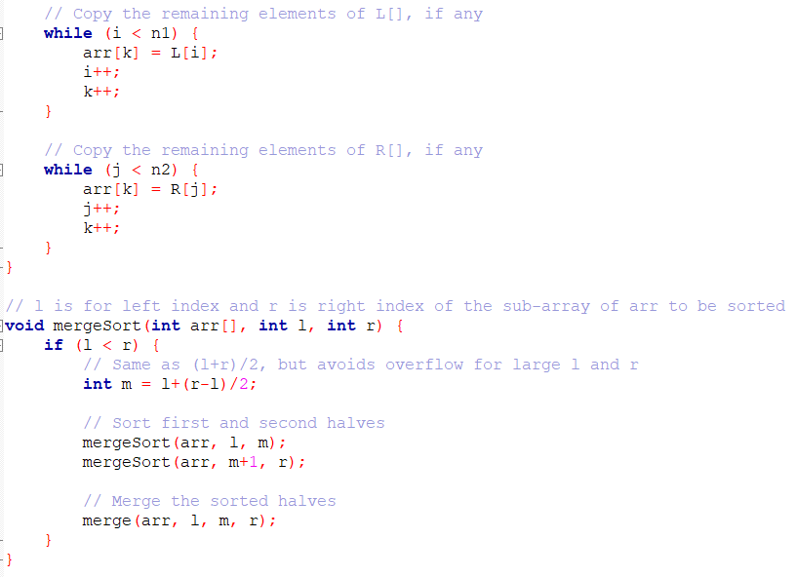
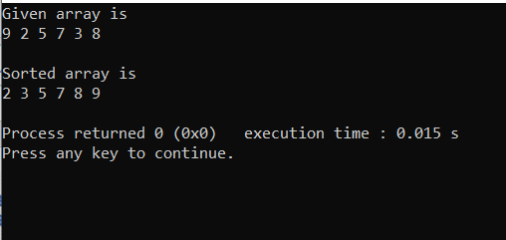
Example:-

Slide 23
Advantages of Merge Sort
Merge sort is efficient for large datasets due to its O(n log n) time complexity.
It is a stable sorting algorithm, meaning it does not change the order of equal elements.
Merge sort is suitable for sorting linked lists as well as arrays.

Slide 24
Disadvantages of Merge Sort
Merge sort requires additional space for storing the sub lists during the merging phase.
It is not an in-place sorting algorithm, which means it may be less memory-efficient compared to other algorithms.
Merge sort has a slightly slower constant factor compared to quicksort for smaller datasets.

Slide 25
Conclusion:
Merge sort is a versatile and efficient sorting algorithm based on the divide-and-conquer strategy.
It offers stable sorting, predictable performance, and is suitable for various applications.
Suitable for large dataset due to time complexity

Slide 26
Heap sort
Sudeep kharel
Roll no. :32

Slide 27
Introduction
Consistent Time Complexity: Heap sort has a time complexity of O(nlogn) in best, average, and worst cases, making it a reliable choice for sorting large datasets.
In-Place Sorting: It requires only O(1) additional space, performing all operations within the original array, which is beneficial in memory-constrained environments.
Binary Heap Data Structure: Heap sort uses a binary heap (max-heap) to efficiently manage and sort elements, leveraging the heap property to repeatedly extract the largest element and rebuild the heap until the array is sorted.

Slide 28
Heap Sort Algorithm
Build Max Heap: Construct a max-heap from the input array.
Extract Max: Repeatedly extract the maximum element and place it at the end of the sorted array.
Heapify: Maintain the heap property by heapifying the reduced heap.

Slide 29
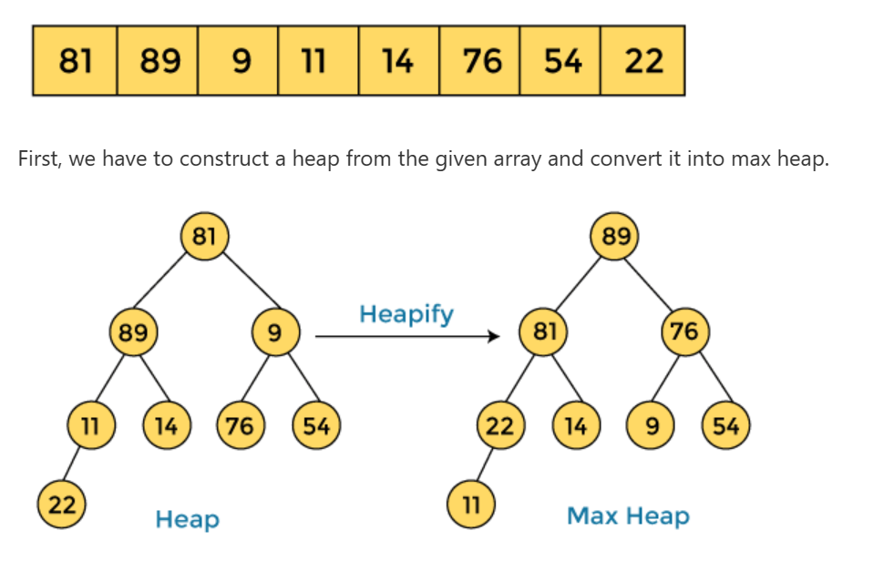
Working of Heap Sort Algorithm

Slide 30
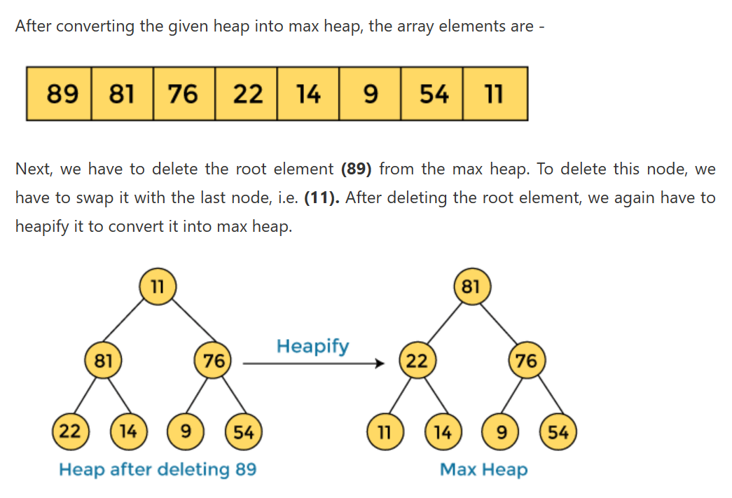
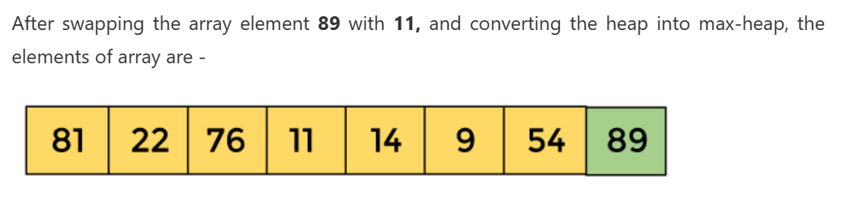

Slide 31
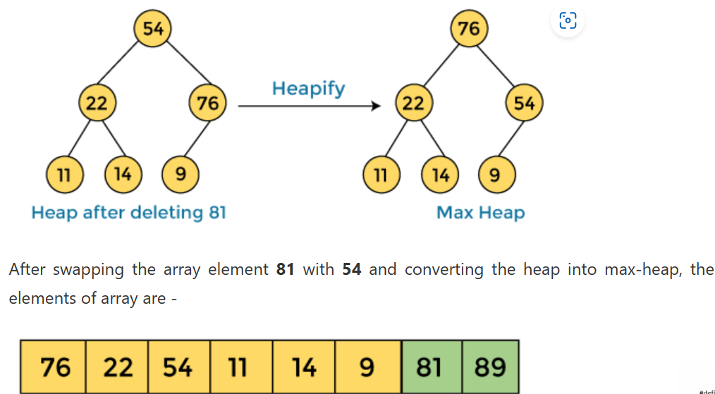

Slide 32
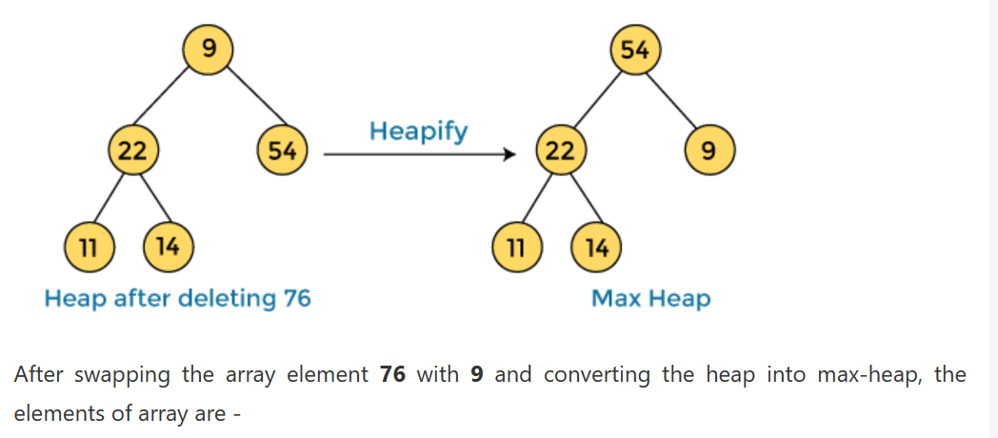
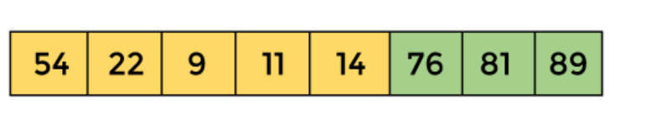

Slide 33
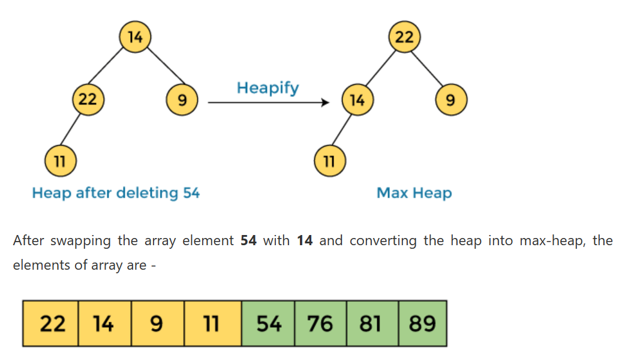

Slide 34
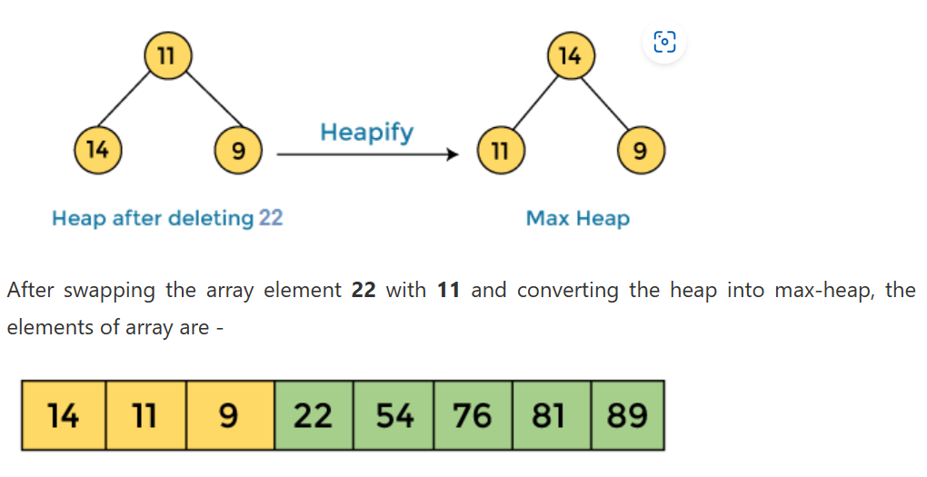

Slide 35
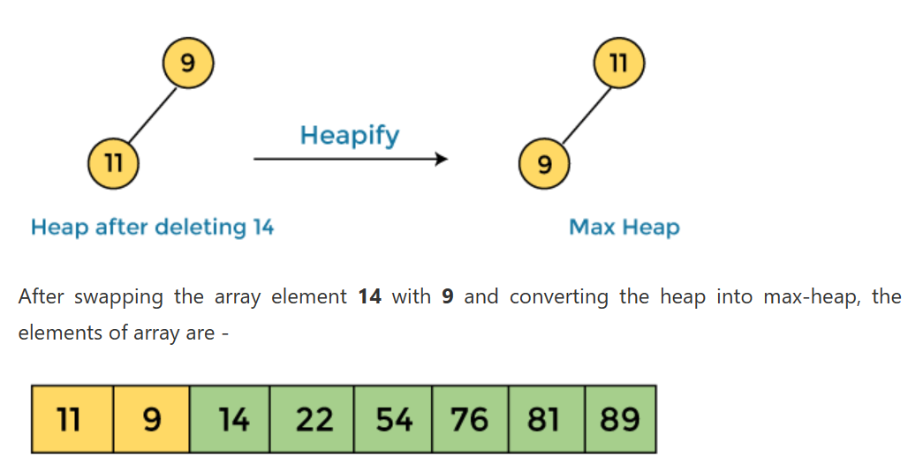

Slide 36
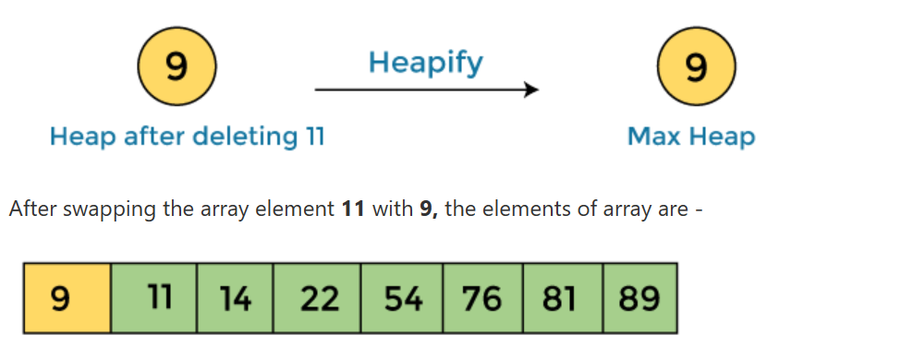
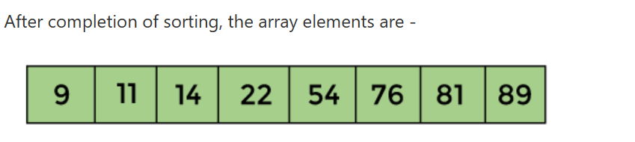

Slide 37
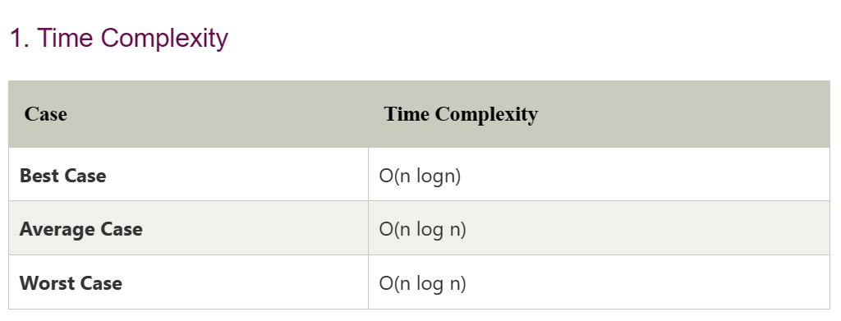

Slide 38
Applications
Priority Queues: Efficient implementation of priority queues, allowing fast insertion, deletion, and access to the highest or lowest priority element.
System Scheduling: Used in operating systems for process scheduling, where processes with the highest priority are selected for execution.
Graph Algorithms: Utilized in algorithms like Dijkstra's and Prim's for efficient shortest path and minimum spanning tree calculations.
Event Simulation: Manages events in discrete event simulation systems, ensuring events are processed in chronological order.
Median Maintenance: Helps maintain the median of a stream of numbers using two heaps to track the lower and upper halves.

Slide 39
QUICK SORT
Niraj Kharel
Roll No.: 16

Slide 40


Introduction
Quick sort works on the idea that an element is on the sorted position if all the elements of its left side are smaller and all the elements on the right hand side are larger elements.
The rest of the element may or may not be sorted.
For example:

Slide 41
Introduction
The naming of the sorting technique itself signifies that it is a quick sorting technique. However, it is not the fastest one.
The algorithm works on the strategy of ‘divide-and-conquer’ where problems are split into smaller chunks and these chunks are solved.

Slide 42
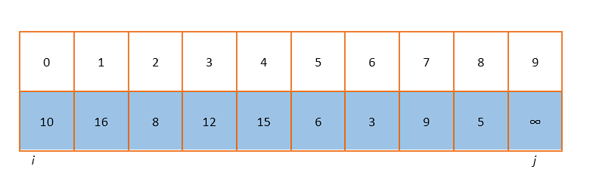
How it works?
Let us consider an array of 9 elements which is to be sorted using the quick sort algorithm.
Initially, we set the value of i as 0 and the value of j as the position of element that has the highest value. (Here, we have added a large number at the end)

Slide 43
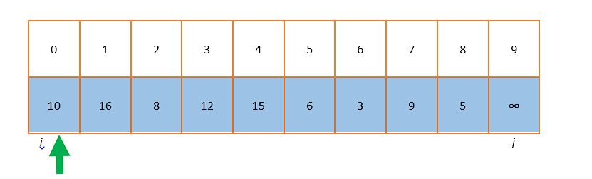
How it works?
The first element is chosen as the pivot element. Here, the pivot element is 10.
Now i is increased until we encounter an element larger than pivot element. Also, j is decreased until we encounter an element smaller than the pivot element.

Slide 44
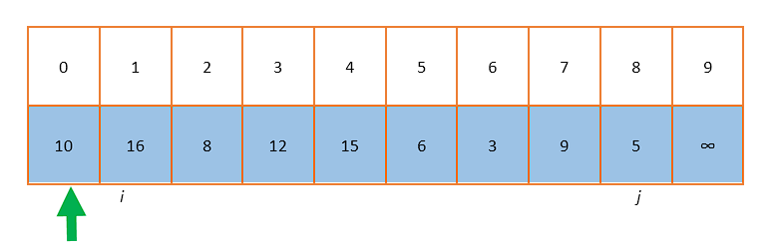
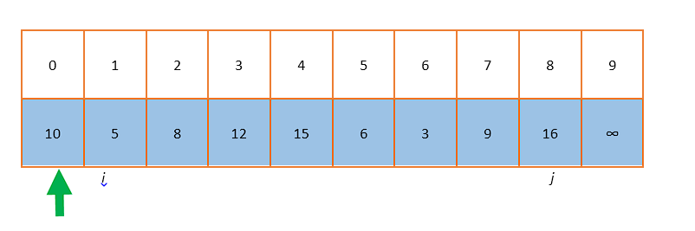
How it works?
As we increase i, the value that is greater than 10 (pivot element) is found at the position 1. Likewise, as j moves, the value smaller than pivot element is found at position at 8.
Then, the elements at those two position is swapped.

Slide 45
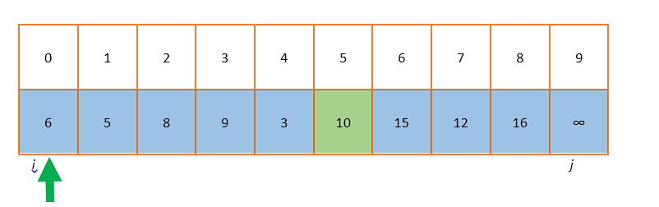
How it works?
The above process is repeated until i crosses j i.e. until the value of i becomes greater than j.
At that instance, the element at the jth position is swapped with the current pivot element. Then, the element at the first position becomes the new pivot element.

Slide 46
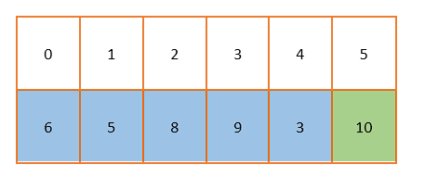
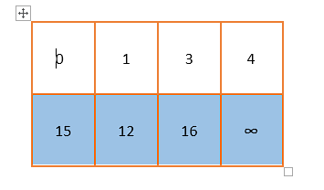
How it works?
Now, the array is partitioned into two parts – one starting from 0 index up to the jth position and another from j+1 th positon to the last position.
The smaller chunks of the array also follow the aforementioned procedure to get sorted elements and finally they add up to form the full array.

Slide 47
Analysis
Quick sort – as the name suggests – is a technique to sort arrays quickly.
Its best time complexity is given by O(n log n), where n is the problem size.
Its worst time complexity is given by O(n^2) and is achieved when the array is already sorted.

Slide 48
THANK YOU
ANY QUESTIONS???

